Slide 1
Intégration continue
IBM Software - Watson IoT
Notes:
If internal presentations are confidential, please add: “IBM Confidential” to the slide masters
Select: View / Master / Slide Master and add “IBM Confidential” to both the title master and slide master
Use sentence case capitalization for presentation titles, slide titles, category labels and bullets: Format / Change Case / Sentence Case. Initial capitalization is limited to our products and offerings.
Applying this template to your existing presentation
Task Pane needs to be viewable: Select View / Task Pane
Select Slide Design - Design Templates from the Task Pane pull-down menu
Select “Browse” at the bottom, and find “Rational_Standard_Template.pot”
on your hardrive and click Apply
Please note that not all slides will reformat appropriately once template is applied. Some reformatting will be necessary
Printing your presentation on a black and white printer
Prior to printing your presentation, view the slides in grayscale mode:
Select View / Color/Grayscale / Grayscale
Select problem graphics or text and right-click and select Grayscale Setting
Select the grayscale setting that displays the problem graphic/text the best
Note: Changing the greyscale setting does not affect the color view
Return to Normal View by selecting View / Color/Grayscale / Color

Slide 2
IBM Rational Team Concert
Une solution intégrée pour les équipes de développement
Planification
Gestion des éditions & itération
Suivi des charges consommées et à venir
Plusieurs processus disponibles en standard
Visibilité sur les projets
Dashboards paramétrables (viewlet)
Indicateurs et rapports en temps réel
Suivi des étapes clés des projets
Gestion des sources
Gestion des activités
Gestion des Builds
Organisation en stream (axe de développement)
Structuration du référentiel en composant
Baseline des composants
Aide à la réconciliation
Connecteur CC
Anomalie, évolution
et adoption
Editeur de requête, partage des requêtes,
Hiérarchisation et typage des demandes
Connecteur Change & CQ
Traçabilité sur les activités
Build local ou sur un serveur distant
Intégration continue
Déploiement continue (Urbancode)
Build z/Os, JCL, Rexx
Make, ANT, Jenkins…
Jazz Team Server
Structure de définition des projets et des équipes
Processus global adaptable à plusieurs niveaux : projet, release, itération, équipe.
Juridiction : contrôle des opérations par rôle
Team advisor : Aide dynamique au respect du processus pour une prise en main rapide
Collaboration dans le contexte : permet aux équipes de communiquer dans le contexte de leurs activités (intégration jabber / Lotus Sametime)
Notes:
Rational Team Concert est bâti sur un socle technique Jazz (Jazz Team Server) qui fournit nativement :
Des notions partagées de projets, d’équipes et de rôles;
Des processus souples et adaptables à l’aide de workflows et d’autorisations définies à partir des rôles au sein de l’équipe
Des capacités de collaboration dans le contexte du travail en cours, de partage d’informations sur les événements, de messagerie instantanée intégrée (en s’intégrant avec Lotus Sametime ou Jabber)
Un référentiel partagé stocké dans une base de données (DB2, Oracle ou Derby)
Les fonctions du serveur Jazz étant mises en œuvre sur un serveur d’applications (WAS ou TomCat)
RTC inclue et intègre les trois grands modules techniques nécessaires au développement et à la gestion des changements et des livraisons :
Un module de gestion des sources (SCM), permettant des développements en parallèle et des intégrations maîtrisées du code des différents développeurs, qui peut aussi s’appuyer sur des investissements existants (ClearCase, CVS/Subversion)
Un module de gestion des activités (Work Items), permettant de créer et suivre les tâches de développement (correction de défaut, demande d’évolution…) à l’aide de workflows adaptables. Cette gestion des activités est intégrée à celle des sources, permettant ainsi de retrouver automatiquement les sources modifiés pour une correction de défaut par exemple. Là aussi, ce module peut s’appuyer sur des investissements existants comme ClearQuest.
Un module de gestion des fabrications (Builds), qui permet d’automatiser les processus d’intégration et de fabrication du logiciel à livrer. Ce module est intégrée aux deux précédents, permettant ainsi de connaître le contenu d’une livraison en termes de défauts corrigés ou de demandes d’évolution prises en compte avec les créations ou modifications de code source correspondant. De la même manière que pour les deux autres modules, il peut s’appuyer sur des outils existants comme Rational Build Forge ou Open source comme Ant, Maven…
La gestion et la coordination des activités sont effectuées à l’aide de plans d’itération, plans qui peuvent être basés sur des processus prédéfinis dont des processus de développement agiles. Ces plans sont intégrés avec les tâches (work items) exécutées par les membres de l’équipe, permettant ainsi d’avoir des plans toujours à jour.
Toutes les informations sur les projets, leur avancement, … sont accessibles en temps réel à l’aide de rapports et de tableaux de bord au moyen d’une interface Web 2.0.

Slide 3
Continuous Integration Key Practices
Automate the Build.
Make Your Build Self-Testing.
Commits to the Mainline after personal build
Build often the Mainline source on an Integration Machine.
Keep the Build Fast.
Test in a Clone of the Production Environment.
Make it Easy to Get the Latest Executable.
Everyone can see what's happening.

Slide 4
Automate the Build
You need to implement an automatic build process: compiling, unit testing, loading binary objects on a test machine, running a script to load/update database schemas, and packaging and deploying web applications …).
RTC implements a Team Build component which provides support for the automation and monitoring of regular builds.
You can use any scripting technology (Make, Perl, Ant, DOS batch files, Maven, Jenkins, Sonar, etc) to create build scripts that interact with the RTC Build component.
The following generic build-related items are stored in the RTC repository and support the build process:
  Build definition: Defines a build script and other parameters
  Build engine: Represents a build system running on a build server.
  Build request: Represents a request to run a build.
  Build result: Represents the output from a build.

Slide 5
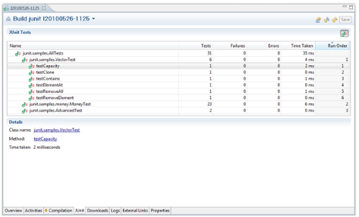
Make Your Build Self-Testing
Include some automated tests in your build process that will help to detect errors quickly
If possible, execute a sub-set of the system tests as part of the build
RTC includes support for execution and result analysis of different unit test frameworks like: CPPUnit, JUnit, MSTest and Nunit.

Slide 6
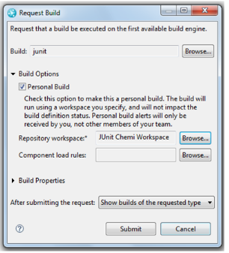
Commits to the Mainline after personal build
A development team adopting Continuous Integration practices should encourage its developers to commit at least once per day.
A personal build lets a developer execute a build against the personal workspace, so he/she can know if his/her code will break or not the build before committing any code change to the stream.
Developer that delivers the changes should be responsible for monitoring the integration build and fix it if there is any problem.

Slide 7
Build often the Mainline source on an Integration Machine
It is very important to ensure that an integration build is run on an integration machine very often when some changes are commited.
Developers that deliver changes should be responsible for monitoring this integration build and fix it if there is any problem.
Developers are expected to commit to fixing problems with the build quickly, resulting in a successful build every day.
A scheduler can be executed for automatic builds (daily, weekly basis, etc...)
Another approach is to ensure that an automatic build will be executed after a code commit to the stream

Slide 8
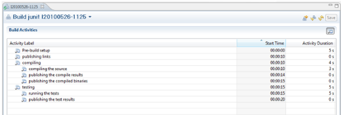
Keep the Build Fast
It is important to reduce to a minimum the time spent running the integration build each time a developer commits changes to the main development stream
With RTC, you can split your integration build into several smaller builds : create a commit build that compiles and verifies the absence of critical errors and run more complex and complete builds later
RTC gives the information about the duration of each activity. So developers in charge of the build script can detect possible areas to improve.
For speeding up continuous builds, each sub-team may have their own stream and run continuous builds until they are free of critical errors, and then deliver to a higher level integration stream to run a complete team build.

Slide 9
Test in a Clone of the Production Environment
You should have a test environment as similar as possible to your final production environment.
RTC Build component can be installed in multiple environments (working against the same RTC server). Therefore it is easy to setup several build environments (development, integration and production)
You can execute the builds with different scheduling in each environnement.

Slide 10
Make it Easy to Get the executable and fix builds
Many people may need to get access to the latest executable to be able to run it or just to see what changed last week
Many times developers are not able to find it because there is not a well known place where these files are stored
RTC enable builds to publish outputs (executable program, packaged zip file, or other artifacts.) and the generated artifacts can be available in the build result editor, on the Downloads page.
What happens when there is a problem in production with a specific version of the code? How can we recreate exactly the environment used in that version?
RTC creates a snapshot used in the build and such information is attached as part of the build results. RTC lets the developer to recreate a Repository Workspace from that snapshot.

Slide 11
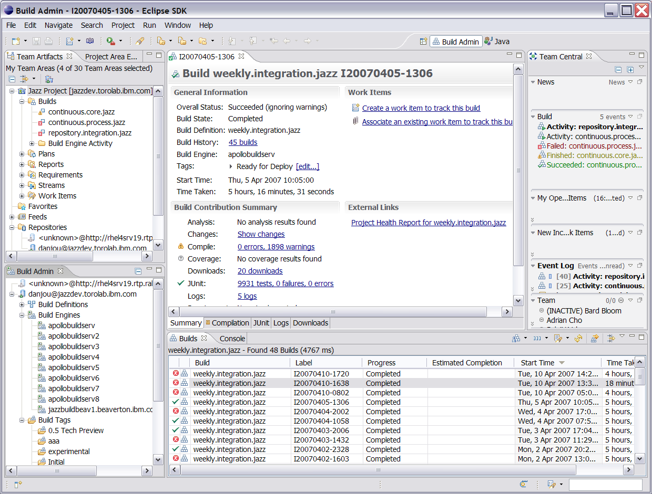
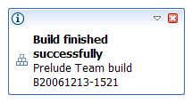
Build from a User Perspective
My builds
Recent builds
Published
build
Administration
of builds and build engines
Alerts
History
Notes:
Animated slide!
Quick flyby of information that is included in the Jazz tutorial regarding build. More UI exposure in the build lab

Slide 12
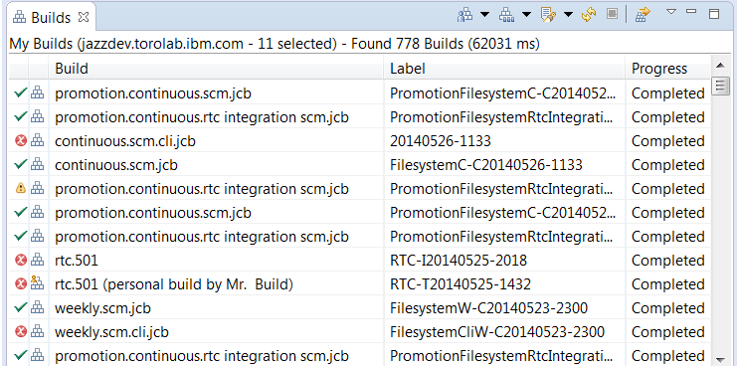
Build View

Slide 13
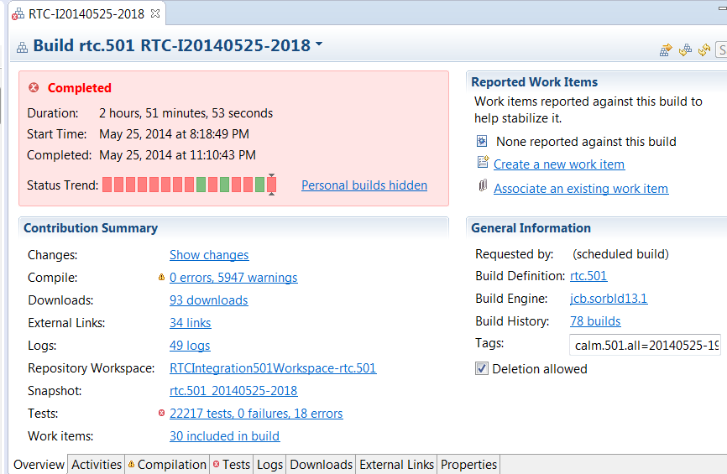
Build Result

Slide 14
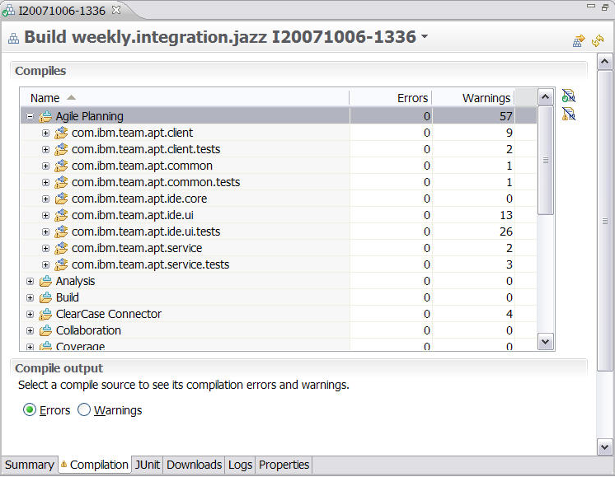
Build Result (compilation)

Slide 15
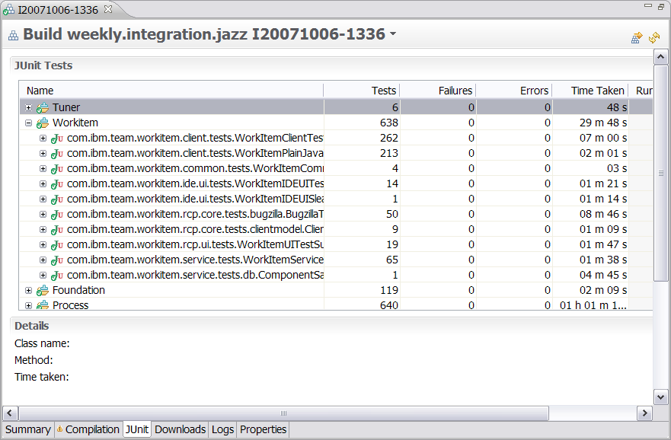
Build Result (unit testing)

Slide 16
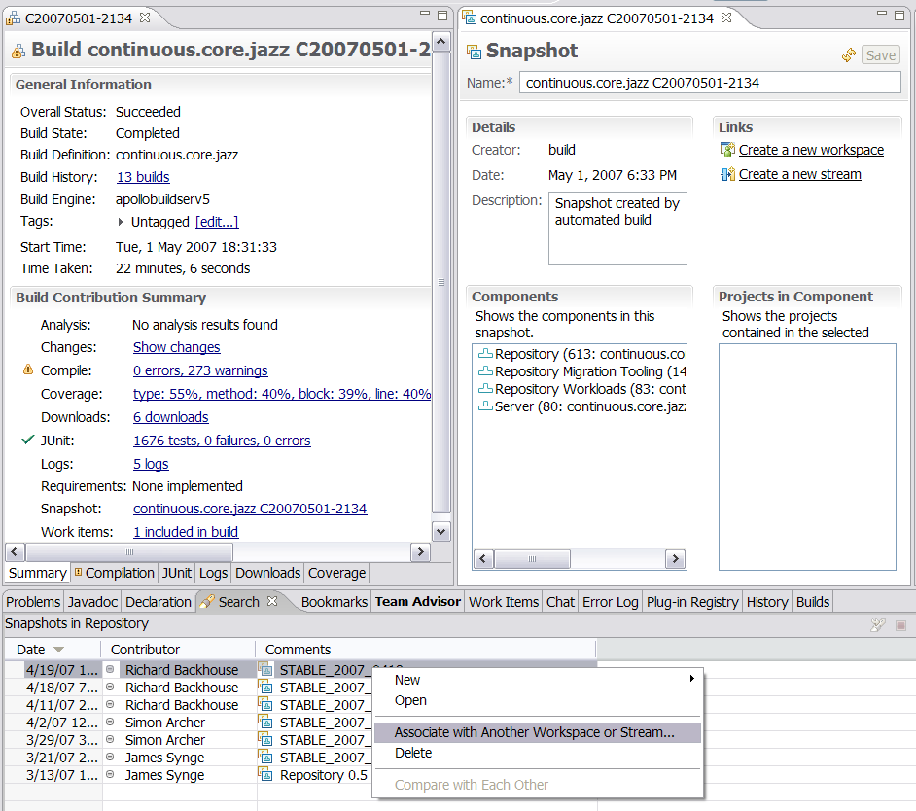
Build and Snapshots
A snapshot captures an important workspace configuration for later recreation
A build can produce and publish a snapshot of the build workspace
A snapshot can provide the base for a build that must be repaired, maintained (milestone, release..)
Notes:
Animated slide
For example Jazz 0.5 was a major milestone. A snapshot from that build was kept and became the source for a new stream for 0.5 maintenance.

